Slide 1
Deep Learning Hardware, Libraries, and First Steps
What you need to know to get serious about deep learning
Tim Dettmers
@tim_dettmers

Slide 2
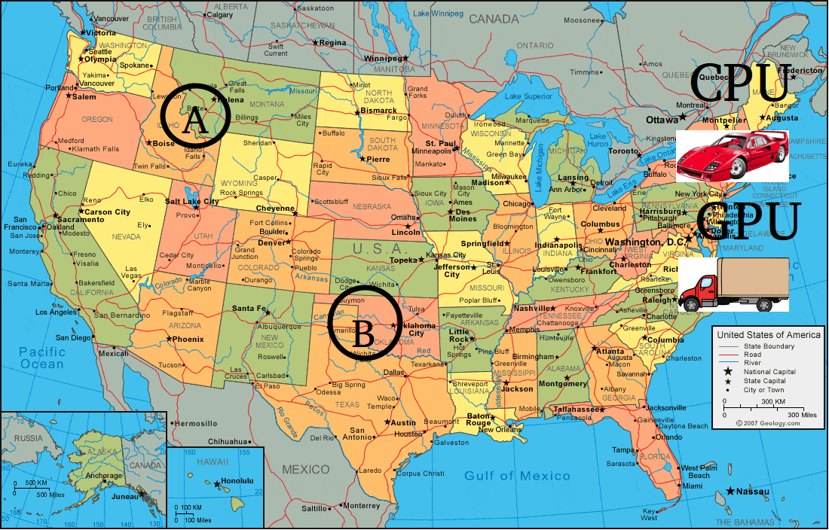
What makes GPUs so fast?

Slide 3
Why NVIDIA GPUs? Software.
Matrix multiplication optimized for over 10 years
Convolution optimized over 4 years in intensive research
cuDNN and cuBLAS extended and improved over many years
Developing new software for AMD GPUs, ASICs, FPGAs, TPUs, Xeon Phis etcetera would take many years
Performance advantages negligible

Slide 4
GPU
If you start to do deep learning or if you want to compete on Kaggle.com: GTX 1060
If you work with large data sets which also have large input size (250GB of color images + 250^2 pixels; or video): NVIDIA Titan X or GTX Titan X
Otherwise the best all-rounders are GTX 1070 and GTX 1080

Slide 5
General hardware
Get a SSD especially if you work with images
CPU does not matter for deep learning performance, buy a cheap one
RAM does not matter for deep learning performance
Buy motherboard with PCIe 3.0 if you can

Slide 6
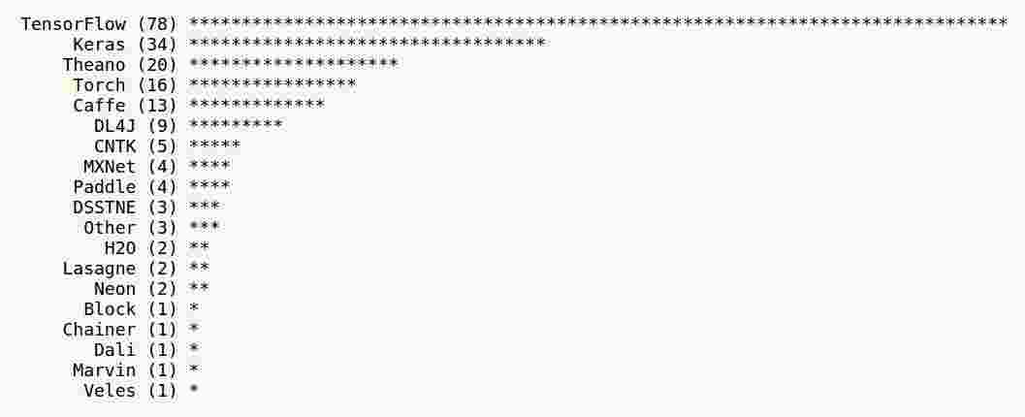
Software
Notes:
Source: https://news.ycombinator.com/item?id=12391744 (google: hackernews deep learning framework poll)
6

Slide 7
Using deep learning in startups
80% of time spend on messy data and “making it work”
Old vs very new algorithms
Inference often more problematic than training
Practical experience most valuable, e.g. Kaggle and hackathons
Read papers on a need-to-know basis and keep up with hyped research
TensorFlow + Flask + GTX 1070
Notes:
7

Slide 8
Big data/small data and industry
Data can be messy, but main challenge is to go from prototype to application
Good rule: Product should work without deep learning; best to improve existing product
Learning to train models important; Kaggle experience valuable
Focus on practical experience, rather than reading papers
GPU memory can be a problem: NVIDIA Titan X or GTX Titan X. Keras is your friend. TensorFlow is good. Use Cognitive Toolkit (CNTK) for large DL systems.

Slide 9
Using Deep Learning on Kaggle.com
Feature engineering still most important
Understand “how data behaves” for certain algorithms
Read “How I did it”-threads from winners
Replicate past winners solutions
Try to get a good score on many competitions quickly
Notes:
9

Slide 10
Starting in research
Read, read, read
Learn to adapt architectures and train them
Understand how training behavior changes when you exchange components
Become good at adding new high-level code
Learn math on a need-to-understand basis
GTX 1070/1080 or NVIDIA Titan X (CV)
TensorFlow, Torch7, Caffe, Brainstorm

Slide 11
Bibliography
Why are GPUs well-suited to deep learning?
Are FPGAs the next step?
GPU in depth advice
Deep learning hardware guide
Hackernews poll for deep learning software
Deep learning usage in google search
What makes a successful Kaggle competitor
Overview over Caffe/Torch/TensorFlow/Theano

